Slide 1
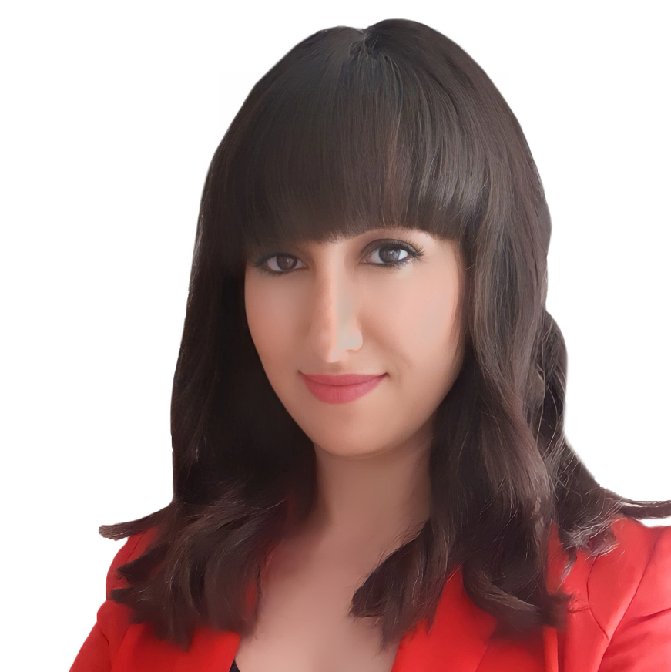


HELLO,
LET ME INTRODUCE MYSELF…
YOSRA
ABDELHEDI
ENGLISH TEACHER
TUNISIA
English teacher, with a 5-year-experience teaching English as a foreign language to
learners of different ages, levels and profiles
LinkedIn
https://www.linkedin.com/in/yosra-abdelhedi-
E-mail
Yosra,abdelhedi,pro@gmail.com

Slide 2
Philanthropy
Speaking
We Need to Give, Share, and Care

Slide 3
Lesson Objectives
Read for gist
Reinvest new words/expressions in one’s speech
Produce an outline
Produce appropriate intonation patterns
Produce a range of discourse strategies to persuade people to do something
Producing and Delivering a Speech
Functions
Giving information
Suggesting a course of action
Advising others to do something
Persuading others to do something

Slide 4
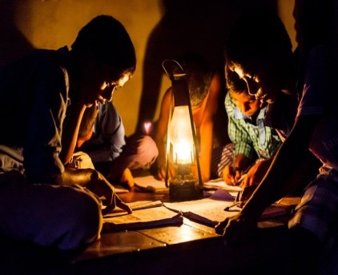
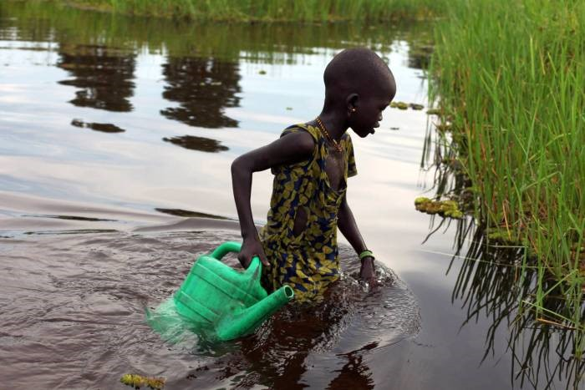
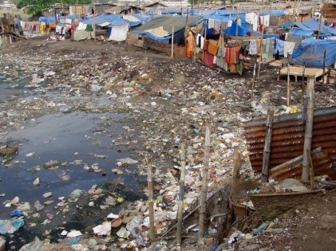
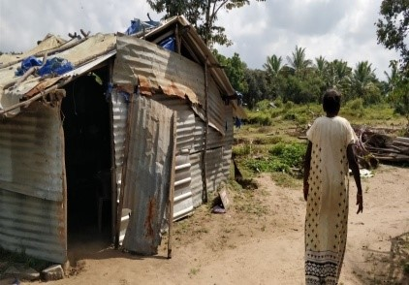
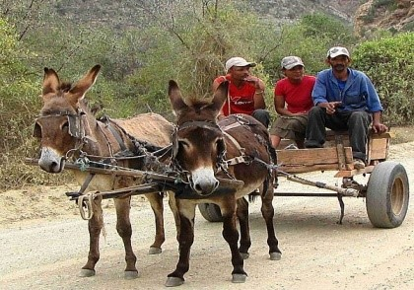
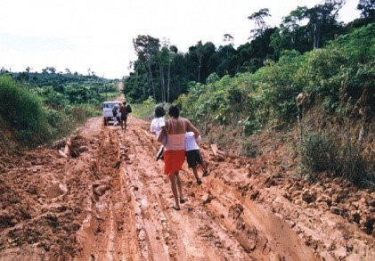
Activity 1: Fill in the blanks with words from the box. sanitation / rural housing / roads / water / electricity / transportation
Absence of .......................... | Absence of .......................... | Absence of proper ………….............
………………………………………………. | Absence of .......................... | Rural ..........................

Slide 5
Activity 1: With reference to the previous activity what do you think those people need
 | decent housing
 | healthy living conditions
 | schools and libraries
 | educational opportunities
 | clean drinking water hygienic living conditions
 | cultural programmes
 | Roads
 | health care centres
 | economic integration
 | money and in-kind contributions

Slide 6
Activity 1: Read the ad on your student book (page 56) then identify the message that Carol Bellamy is sending through it?
Leadership isn’t just for leaders.
“Ensuring the rights and well-being of children is the key to sustained development in every country and to peace and security in the world. Meeting this responsibility fully, consistently, and at any cost, is the essence of leadership.
Yet, commitment and action are required across the board. Not just from governments and organizations, but also from community activists and entrepreneurs, from artists and scientists, from religious leaders and journalists, and from children and adolescents themselves.”
Carol Bellamy,
Executive Director,
United Nations Children’s Funds

Slide 7
Activity 2: How can we help needy people in distanced areas?
 | Join organizations / associations
 | Participate in voluntary work
 | Participate in charity events
 | Donate money, clothes, etc
 | Raise people’s awareness about those people in need

Slide 8
Activity 2: Read the report about UNICEF, then answer the following questions.
UNICEF, acronym of United Nations Children’s Fund, formerly (1946–53) United Nations International Children’s Emergency Fund, special program of the United Nations (UN) devoted to aiding national efforts to improve the health, nutrition, education, and general welfare of children.
UNICEF was created in 1946 to provide relief to children in countries devastated by World War II. After 1950 the fund directed its efforts toward general programs for the improvement of children’s welfare, particularly in less-developed countries and in various emergency situations. UNICEF has concentrated much of its effort in areas in which relatively small expenditures can have a significant impact on the lives of the most disadvantaged children, such as the prevention and treatment of disease; it also provides funding for health services, educational facilities, and other welfare services. Since 1996 UNICEF programs have been guided by the Convention on the Rights of the Child (1989), which affirms the right of all children to “the enjoyment of the highest attainable standard of health and to facilities for the treatment of illness and rehabilitation of health.” UNICEF’s activities are financed by both government and private contributions.

Slide 9
Activity 2: Read the report about UNICEF, then answer the following questions.
Which countries does UNICEF focus on?
What are the UNICEF’s main contributions?
Where does the money come from?
Name other organizations or associations you know in your country or across the globe.

Slide 10
Activity 3:
December 8, is the National Solidarity Day in Tunisia. Your school headmaster / headmistress wants you to
persuade your schoolmates to donate money ,
tell them about the different philanthropic activities from which the needy people will benefit,
state the great social and human values behind the act.
In small groups, prepare a short speech. Follow the outline of the speech (refer back to Section two) then volunteer to deliver the speech. You can use visual aids like posters, brochures , photographs , transparencies … There is more than one way to catch the attention of your audience like asking questions, telling an anecdote ( a very short funny story), citing a quote, giving statistics …

Slide 11
Activity 3: The different features of an effective speech:
 | clear outline
 | greetings
 | grabbing the attention of the audience through a quote, statistics etc
 | introducing, developing and clarifying the key point
 | supporting the key point with different devices (including intonation patterns)
 | giving a counterargument
 | refuting the counterargument
 | concluding and bringing closure to the speech.

Slide 12
Thanks
ANY QUESTIONS

